Slide 1


Electric Circuits
Twelfth Edition, Global Edition
Chapter 5 – Part 3
The Operational Amplifier
© 2024 Pearson Education Ltd. All Rights Reserved.
Notes:
If this PowerPoint presentation contains mathematical equations, you may need to check that your computer has the following installed:
1) Math Type Plugin
2) Math Player (free versions available)
3) NVDA Reader (free versions available)

Slide 2
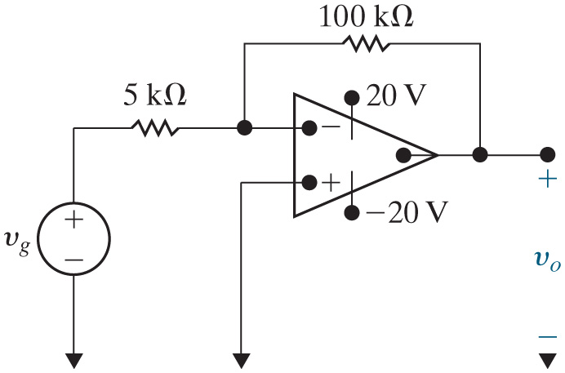


Chapter 5 – Op Amps (2 of 4)
What op amp circuit configuration is shown here?
A. Inverting amplifier
B. Inverting summing amplifier
C. Non-inverting amplifier
D. Non-inverting summing amplifier

Slide 3


Chapter 5 – Op Amps (3 of 4)
Suppose
Assuming the op amp is ideal, what is
A. 10 V
B. −20 V
C. − 10 V

Slide 4
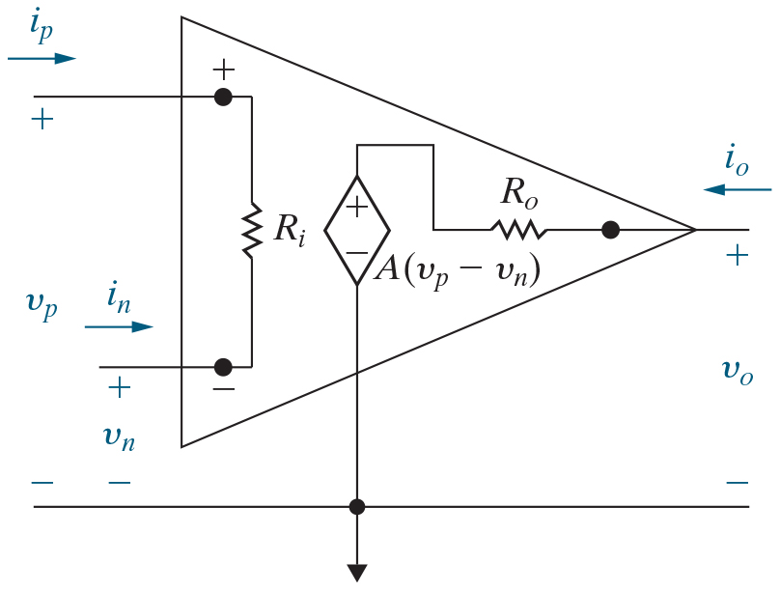
Chapter 5 – Op Amps (1 of 4)
A more realistic op amp model
Predicts op amp behavior in its linear region and includes three modifications to the ideal op amp:
A finite input resistance
A finite open-loop gain
A non-zero output resistance

Slide 5


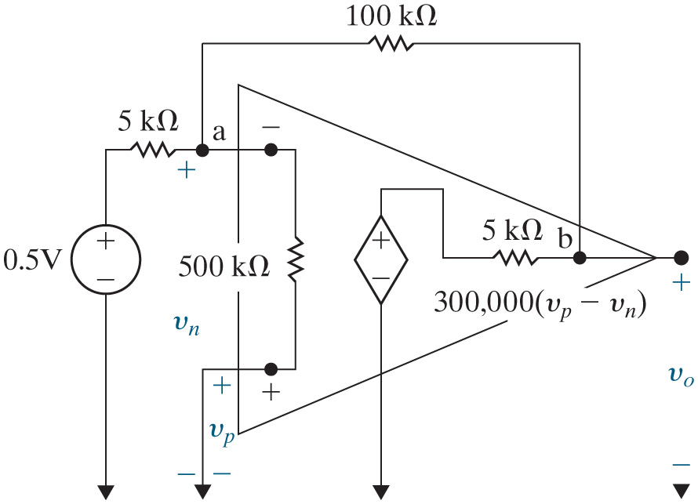
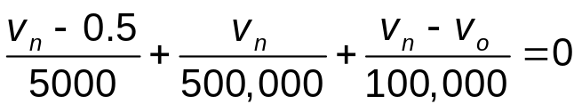
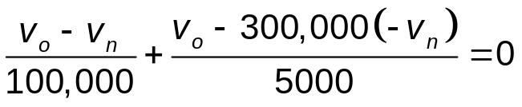

Chapter 5 – Op Amps (4 of 4)
Now let’s use the more realistic model for the op amp to analyze
the inverting amplifier. Assume the input resistance is
the
output resistance is
and the open-loop gain is 300,000.
Write K C L equations at nodes a and b:
node a:
node b:
Using a calculator to solve these equations simultaneously gives
Therefore, the ideal op amp assumptions do a
good job approximating an actual op amp.

Slide 6

Copyright
This work is protected by United Kingdom copyright laws and is provided solely for the use of instructors in teaching their courses and assessing student learning. Dissemination or sale of any part of this work (including on the World Wide Web) will destroy the integrity of the work and is not permitted. The work and materials from it should never be made available to students except by instructors using the accompanying text in their classes. All recipients of this work are expected to abide by these restrictions and to honor the intended pedagogical purposes and the needs of other instructors who rely on these materials.

